Slide 1

Supervised ML - Classification; Capstone Project Predicting Credit Card Default.
Presented By
Samson Ogwuche
Charles Ntamack
On 17th August 2023.

Slide 2
Agenda
Project Synopsis
Current State
Required Actions
Technical Process
Preprocessing &Exploration of Data
Modeling & Interpretation
Takeaways
Data Limitations
Recommendations & Conclusion

Slide 3

Business Case & Objectives
Objectives
Apply Machine Learning (ML) to predict credit card defaults.
Help banks and other lending institutions manage Credit Risk.
Challenges
Total credit card debt in Canada soared to about $100 billion in Q4 2022 while that of the USA is currently over $1 trillion. 22% of credit card customers defaulted in Q4 2022.
Notes:
1. The recent surge in credit card usage globally is a positive indication of financial inclusiveness, however, it portends higher credit risk to banks and other lending institutions.
2. Our project is aimed at helping banks and other credit lending institutions to manage their credit risk by understanding the risk factors that contribute to credit card defaults.
3. Our project used Machine Learning (ML) to predict credit card defaults by customers using a dataset of bank credit card defaults in Taiwan. The result of the model showed that 78% of the customers did not default while 22% of the customers defaulted on the credit card payments.
The model also showed that singles, university students, females, and customers between 24 and 29 years have the highest rate of default on credit card payments.
4. Total credit card debt grew by about 22% YoY as of Q4 2022 compared to the same period in 2021
A survey by Statistics Canada in the Fall of 2022 revealed that 35% of Canadian household is struggling to meet their financial needs and this put pressure on their use of credit cards

Slide 4
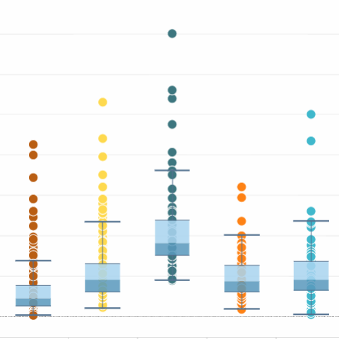
Preprocessing & Exploratory Data Analysis
Missing Values:
No missing values.
Duplicates:
No duplicates.
Skewed variables:
We had skewed variables. We treated them using log transform to handle skewness.
Outliers:
We had outliers but handled them using Cap & Floor.

Slide 5
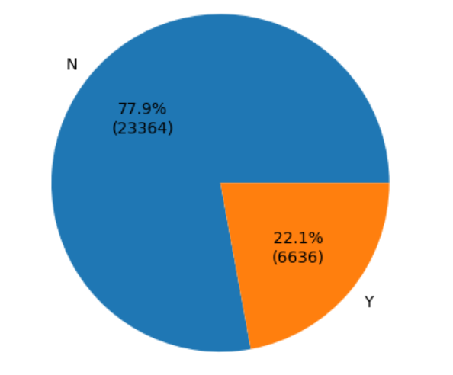
Preprocessing & Exploratory Data Analysis
Default Ratio
Default ratio
22% of the total defaulted on their payments.
78% of the customers did not default.

Slide 6
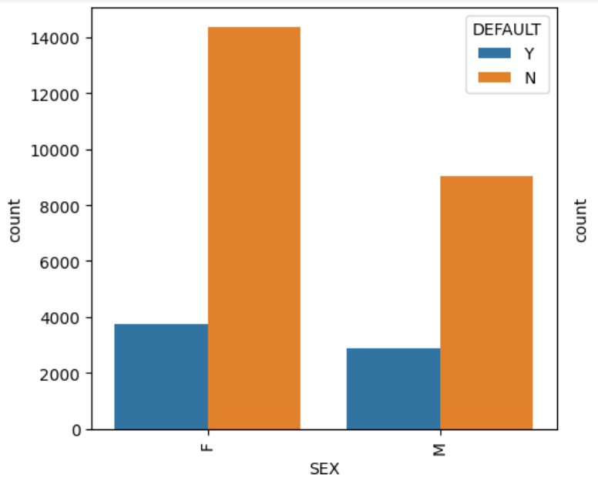
Preprocessing & Exploratory Data Analysis
Default By Sex
Default by Sex
More females gender defaulted on their payments than males.
On aggregate, more females use credit cards than their male counterparts.

Slide 7
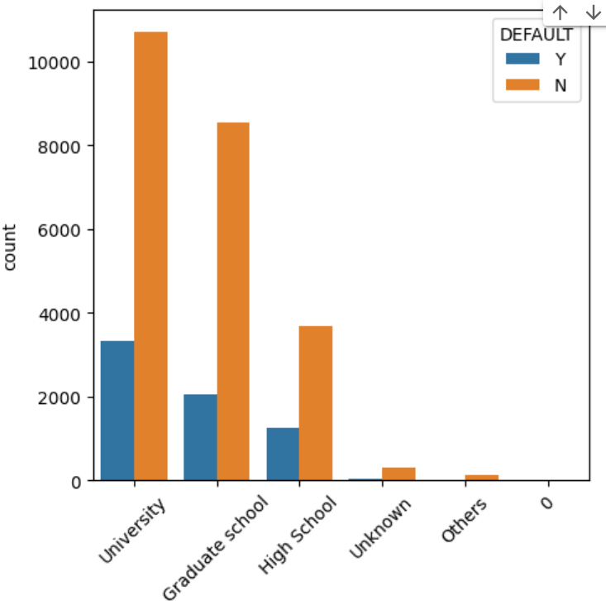
Preprocessing & Exploratory Data Analysis
Default By Level of Education
Default By Level of Education
More university students defaulted on payment than all other levels of education.
More university students used credit cards than all other levels of education.

Slide 8
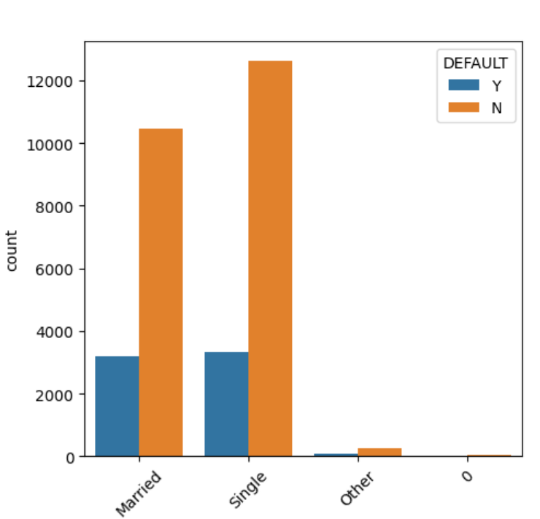
Preprocessing & Exploratory Data Analysis Contd.
Default by Marital Status
Default by Marital Status
The singles defaulted on their payment more than married and others.
More singles subscribed to the used of credit cards than the other customers.

Slide 9
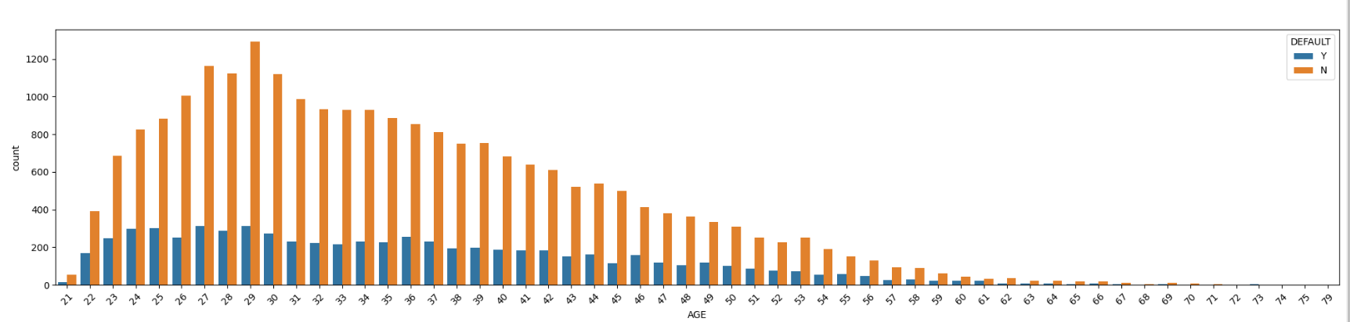
Preprocessing & Exploratory Data Analysis Contd.
Default by Age
Customers 29 years of age used credit cards more than every other customer.
Customers who are 29 years, 27 years, 25, and 24 years defaulted on their payments more than all other customers.
Gen Z and Millennials have a higher rate of default than the baby boomers.

Slide 10
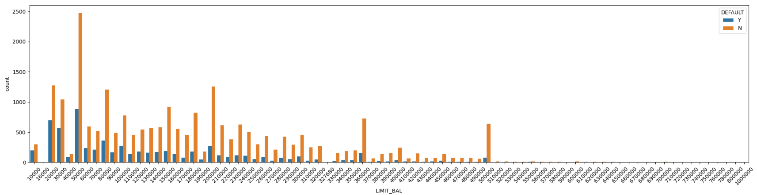
Preprocessing & Exploratory Data Analysis Contd.
Default by Limit Balance

Slide 11
Machine Learning Models & Model Comparison
To test the performance of our findings, we employed machine learning models to test the accuracy and other assessment measures as below. Our primary metrics for measuring performance are accuracy score & ROC/AUC
Model | Accuracy Score | ROC/AUC
Random Forest | 82.37% | 78.18%
Decision Tree | 81.80% | 75.12%
Logistic Regression | 81.51% | 72.82%
Neural Networks | 77.88% | 56.67%
Our best model from the fit statistics is Random Forest.

Slide 12
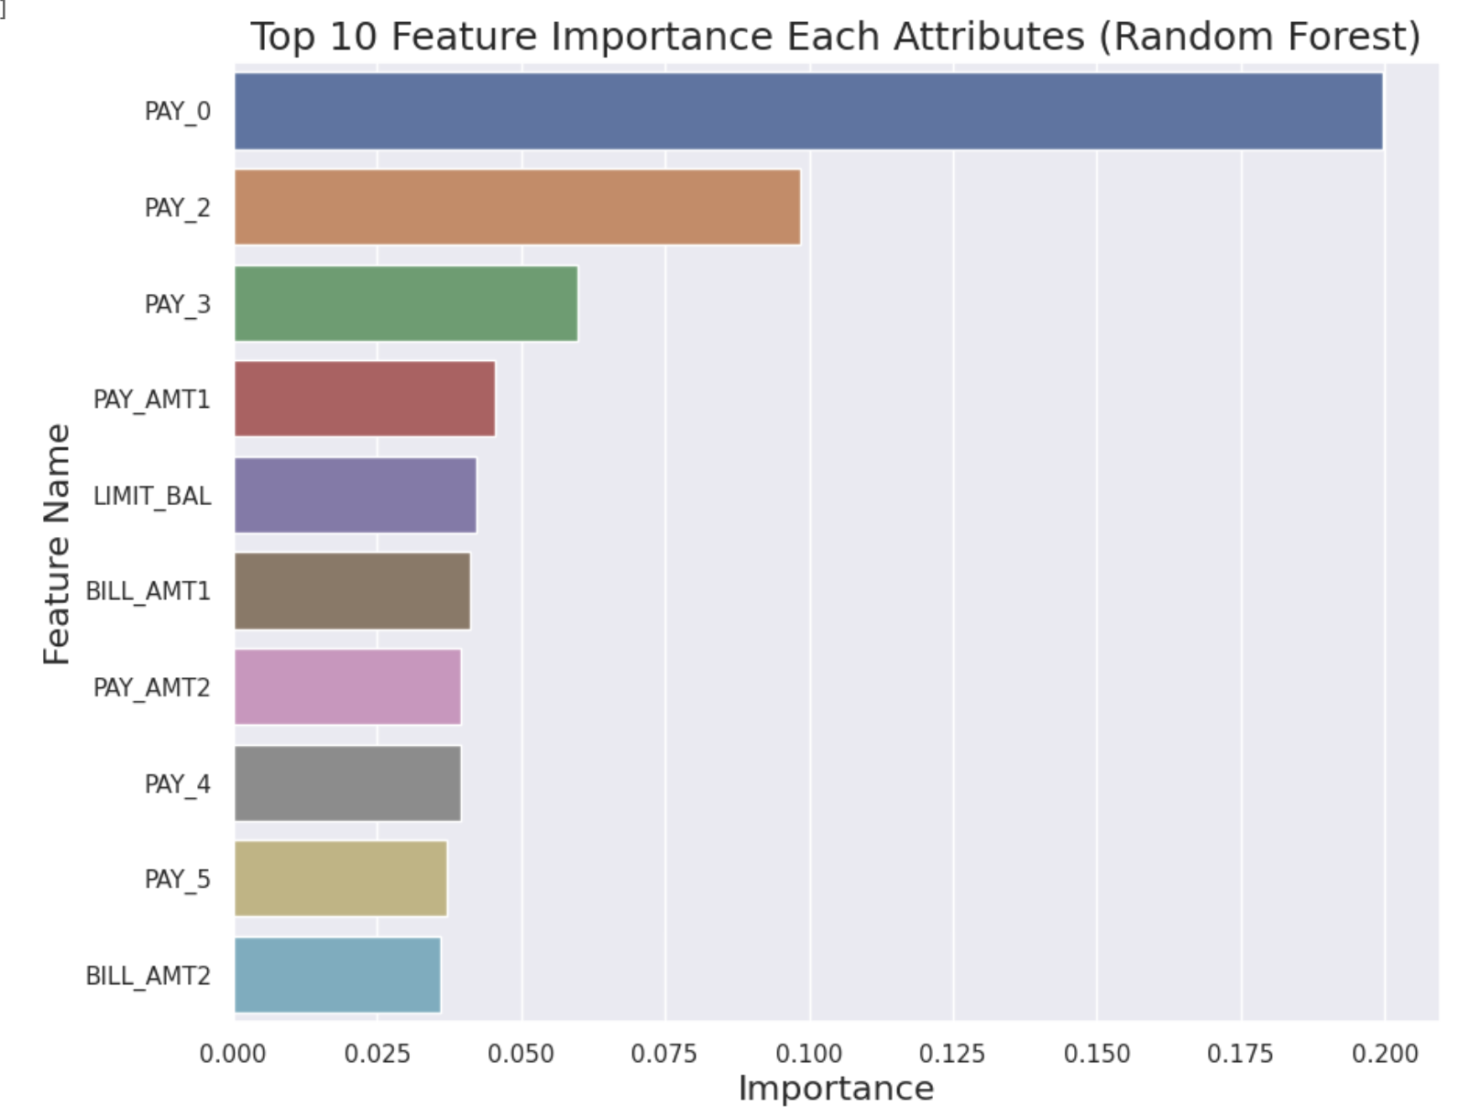
Important Features
Important Features
Important Features
Our most important feature is PAY_0.
PAY_0 contributed 20% in the trained features accounting for the outcome of the model.
PAY_0 – PAY5 are the top features contributing almost 41% of the features of importance in the model.

Slide 13
Model Interpretation
From our model performance, below are the interpretations.
The model’s prediction is 82.37% correct that about 22% of the customers defaulted on their credit card payments.
It is also 82.37% correct that more female customers defaulted on credit card payments than male customers.
The prediction is 82.37% correct that university students and customers who are single defaulted more.
It is 82.37% correct that customers with a limit balance of $50,000 default most.
Customers between the ages of 24 and 29 have the highest rate of default.

Slide 14
Limitations, Recommendations, & Conclusion
Limitations
Data.
Recommendations & Conclusion
Adoption of our ML Model.
Train Credit Analysts on the use of ML.
Improve the Model Accuracy.
Human Factors.
Regulatory Policies & Technology.

Slide 15


Thank you.
This Photo by Unknown Author is licensed under CC BY-SA

